Slide 1

Department of Computer Science & Engineering
SIGN LANGUAGE TRANSLATOR FOR SPEECH-IMPAIRED
Date: 29 May 2021
SOMIREDDYGARI SAMIKSHA : 17WH1A0516
TURIYA DANDU : 17WH1A0536
THONDAPU NEELIMA CHOWDARY : 17WH1A0545
Internal Guide: Mrs. Naga Kalyani.Ayyadevara
Designation : Assistant Professor
BVRIT HYDERABAD College of Engineering for Women

Slide 2
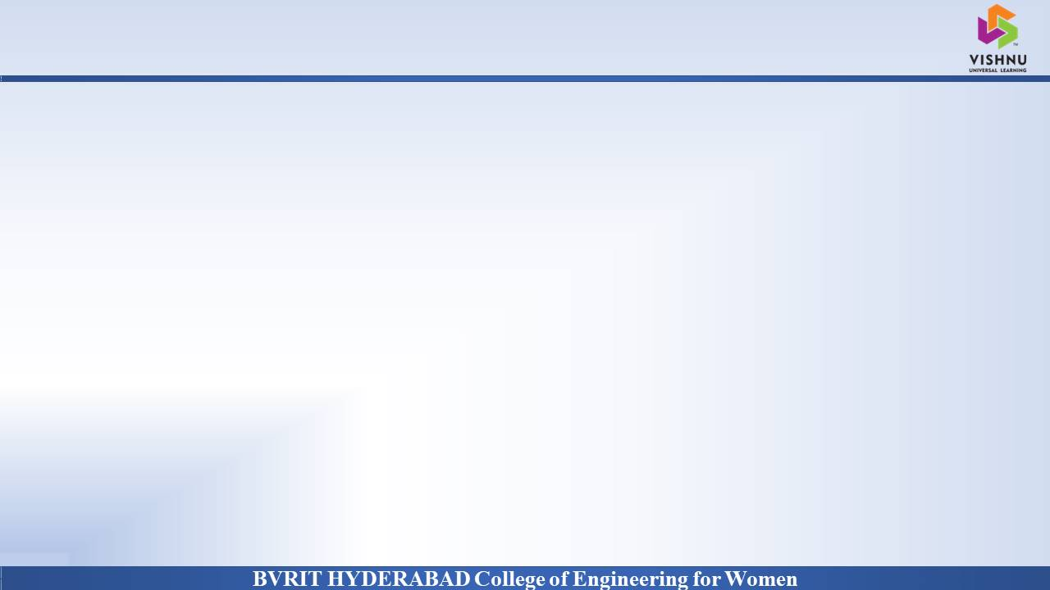
Why Should I Study this course?
Abstract
PROBLEM STATEMENT
Examples
Create Computer application and train a model when shown a real time video of the hand gestures of American Sign Language. Shows output for particular sign in text format on screen.
PROBLEM OBJECTIVE
Although a certain fraction of the world suffers from speech and hearing disabilities, Sign Language is not a wide spread language across the world.
Therefore, to aid with a smoother communication between speaking and non-speaking world, technical development can be introduced. This project proposes an application for it.
BVRIT HYDERABAD College of Engineering for Women

Slide 3
Architecture
Data acquisition
Data preprocessing
Building a deep learning model based on CNN
Class Recognition
BVRIT HYDERABAD College of Engineering for Women

Slide 4
Technology Stack
Python Language
Machine learning
CNN
Packages & Libraries
Numpy, os, cv2
Tensorflow
Matplotlib
BVRIT HYDERABAD College of Engineering for Women

Slide 5

SYSTEM SPECIFICATIONS
ENVIRONMENT | SPECIFICATIONS
HARDWARE | Processor - Intel Core i5 Memory(RAM) - 8GB Storage - 1TB
SOFTWARE | Python(tensorflow) OS- Windows 10 Anaconda Navigator
BVRIT HYDERABAD College of Engineering for Women

Slide 6
CNN
What is CNN: A convolutional neural network, or CNN, is a deep learning neural network designed for processing structured arrays of data such as images.
Features:
Image analysis
How CNN is better traditional networks
Layers in CNN
BVRIT HYDERABAD College of Engineering for Women

Slide 7
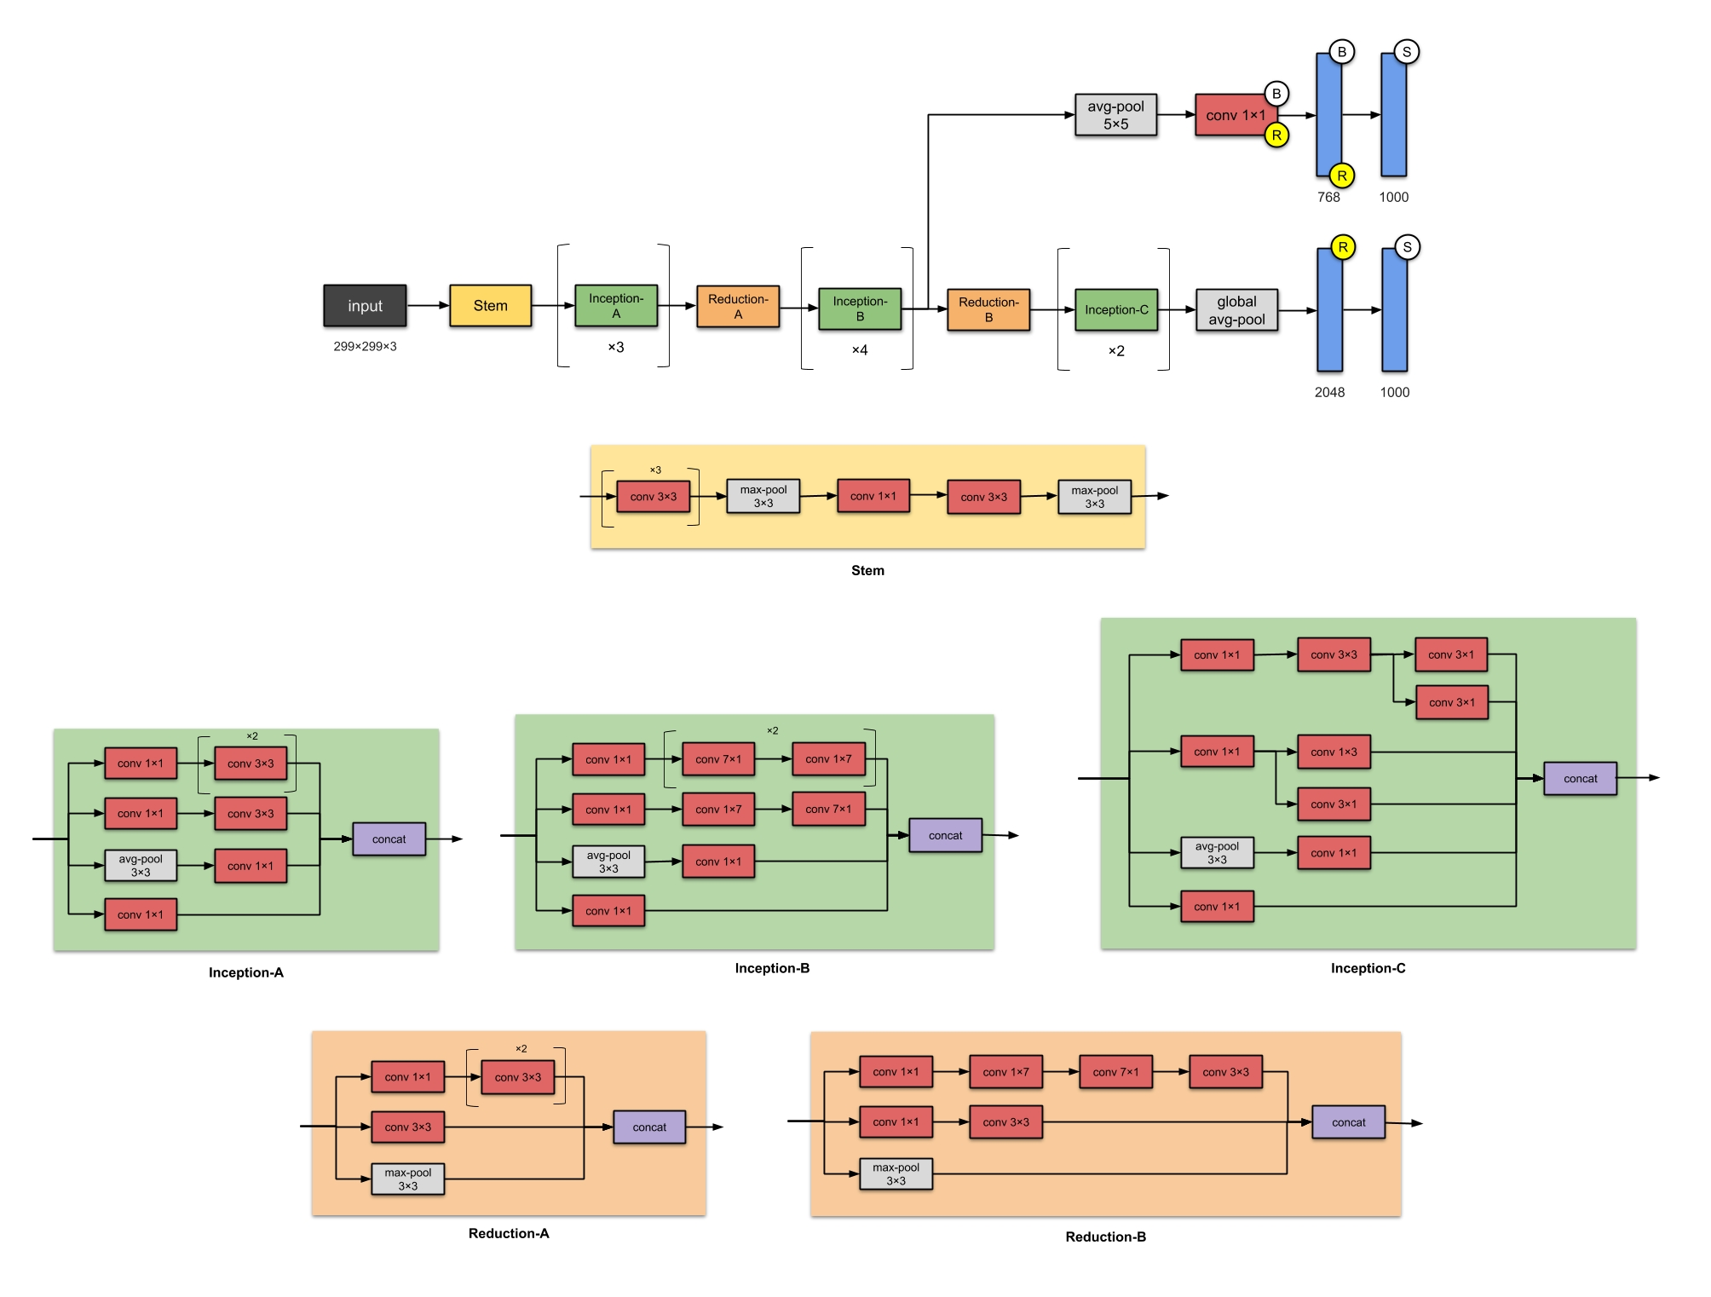
Inception V3
BVRIT HYDERABAD College of Engineering for Women

Slide 8
Test Cases
TestCase ID | Test Scenario | Expected Result | Actual Result | Pass/Fail
TC01 | Check if webcam is switched on | As soon as program is excuted, webcam switched on | As Expected | Pass
TC02 | Checke if video sequentlly are divided into frames for processing | To Process the given hand gesture, each frame is captured from video sequences | As Expected | Pass
TC03 | Check if bouding box is displayed | As soon as program is excuted, bounding box(Green box) displayed | As Expected | Pass
TC04 | Check if hand gesture is deteceted | As soon as hand gesture will be detected | As Expected | Pass
TC05 | Check if alphabet along with its confidence is dipalyed or not | After prediction happens, alphabet along with its confidence for that respective gesture is dispalyed | As Expected | Pass
TC06 | Check if nothing is displayed, when nothing is infront of camera | Nothing will be displayed, if no gesture is placed. | As Expected | Pass
BVRIT HYDERABAD College of Engineering for Women

Slide 9
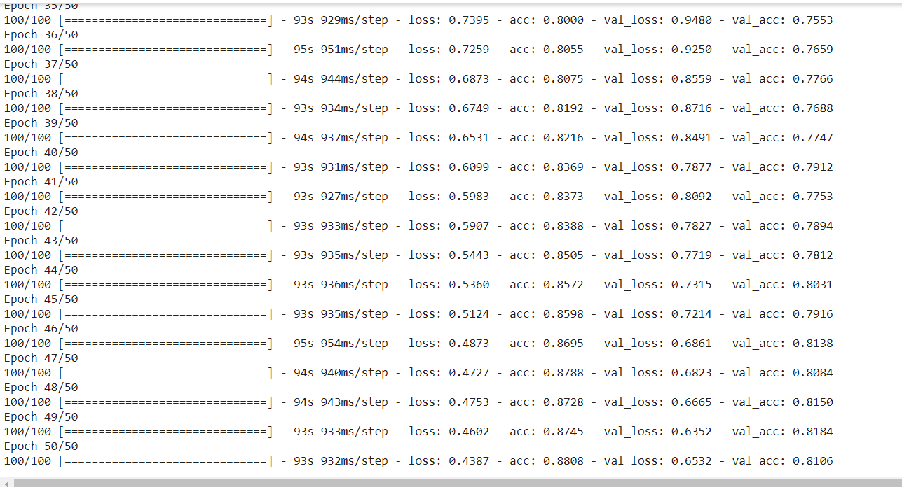
Training Output
BVRIT HYDERABAD College of Engineering for Women

Slide 10
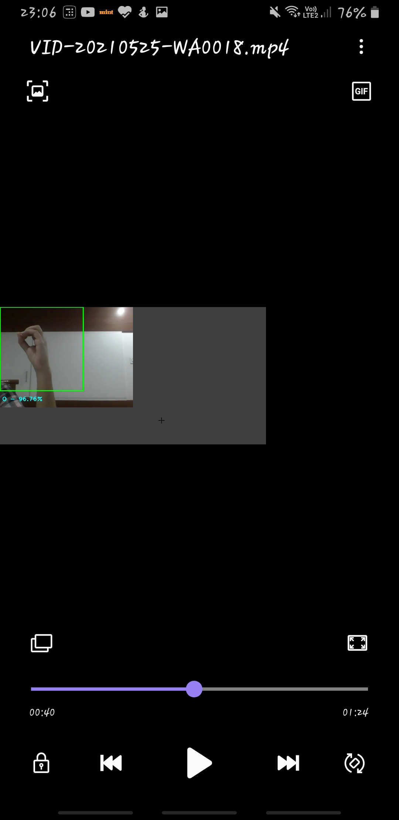
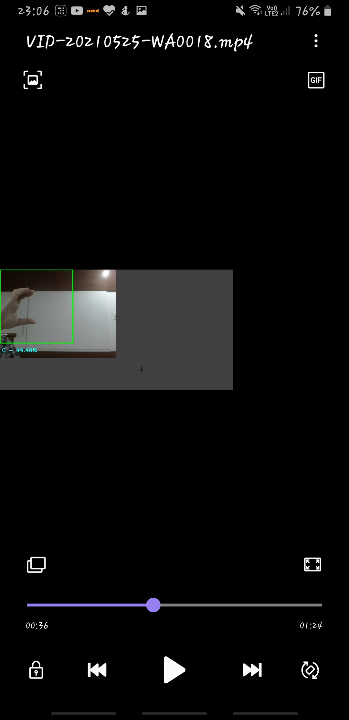
Output
BVRIT HYDERABAD College of Engineering for Women

Slide 11
TimeLine
 | Identifying Business Case Requrements & Specifications
 | Data Gathering
 | Data PreProcessing & Training
 | Data Prediction Project Report
Review 0
Review 1
Review 2
Review 3
BVRIT HYDERABAD College of Engineering for Women

Slide 12
References
Base Paper:
https://ieeexplore.ieee.org/document/9225422
Convolutional Neural Network:
https://medium.com/nybles/a-brief-guide-to-convolutional-neural-network-cnn-642f47e88ed4
Data Set:
https://www.kaggle.com/grassknoted/asl-alphabet
BVRIT HYDERABAD College of Engineering for Women

Slide 13
Thank you
BVRIT HYDERABAD College of Engineering for Women

